Slide 1

COMPUTER GRAPHICS
Hochiminh city University of Technology
Faculty of Computer Science and Engineering
CHAPTER 04:
Input & Interaction

Slide 2
OUTLINE
Basic Input Devices
Window-based Programming
Keyboard Event
Mouse Event
Reshape Event
Idle Event

Slide 3
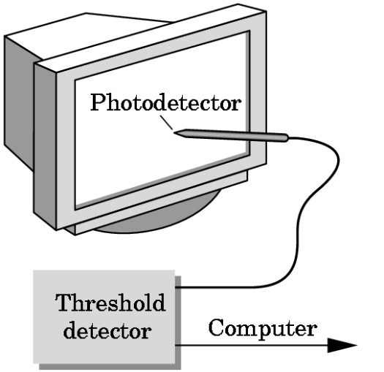
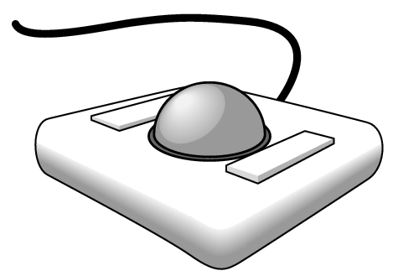
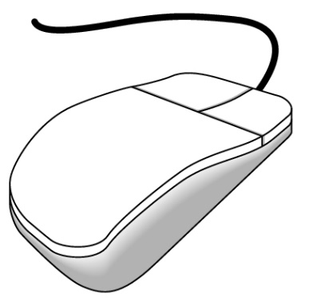
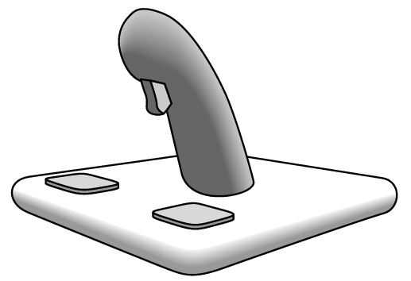
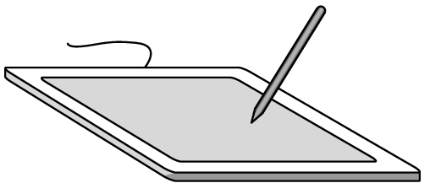
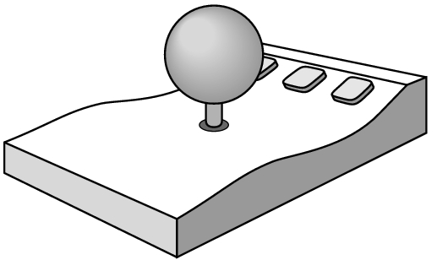
Basic input devices
Physical Devices
mouse
trackball
light pen
data tablet
joy stick
space ball

Slide 4
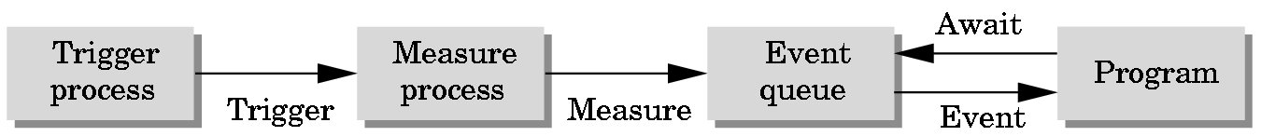
Windows-based programming
Event Mode
Most systems have more than one input device, each of which can be triggered at an arbitrary time by a user
Each trigger generates an event whose measure is put in an event queue which can be examined by the user program

Slide 5
Windows-based programming
Event-driven programming
Event queue
Callback function
Register callback function
glutDisplayFunc(myDisplay)
glutReshapeFunc(myReshape)
glutMouseFunc(myMouse)
glutKeyboardFunc(myKeyboard)

Slide 6
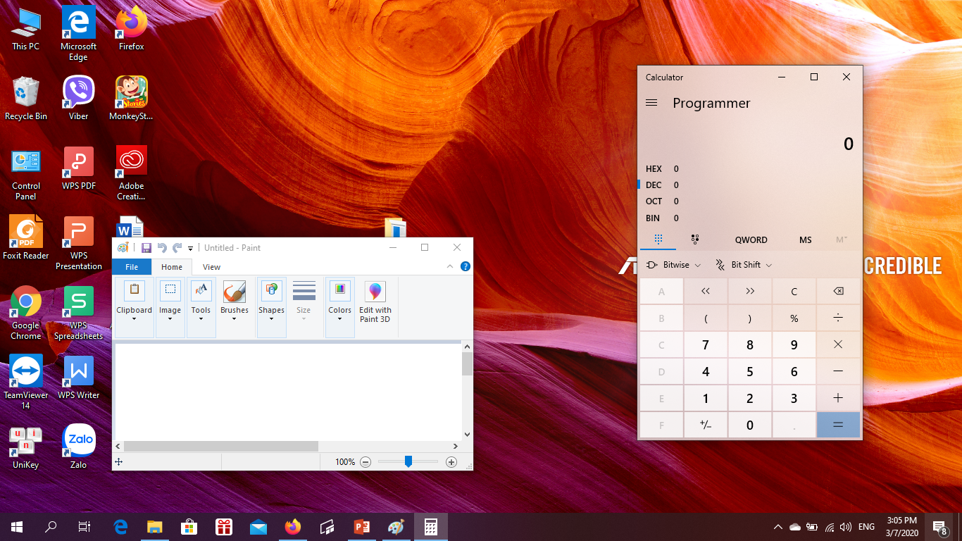
Windows-based programming

Slide 7
Windows-based programming
ID:….
Event:…
X: …
Y: …
……

Slide 8
Windows-based programming

Slide 9
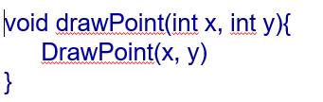
Windows-based programming
Event Queue

Slide 10
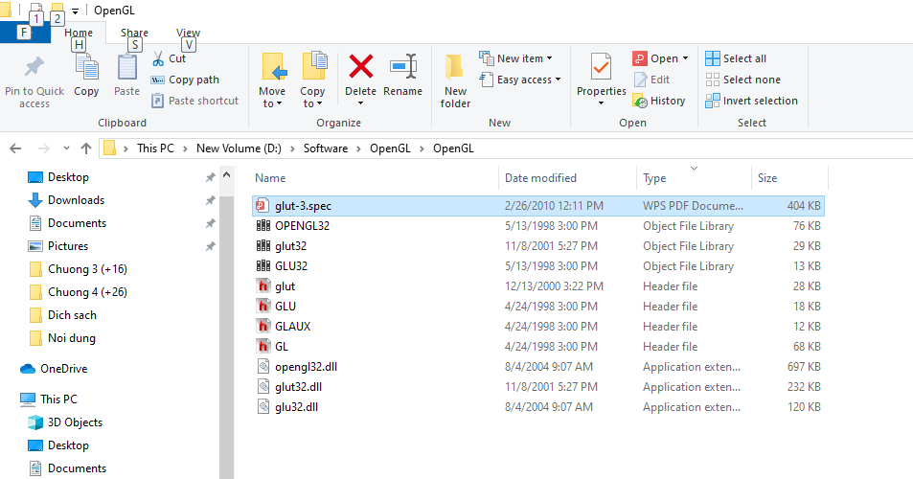
Windows-based programming

Slide 11
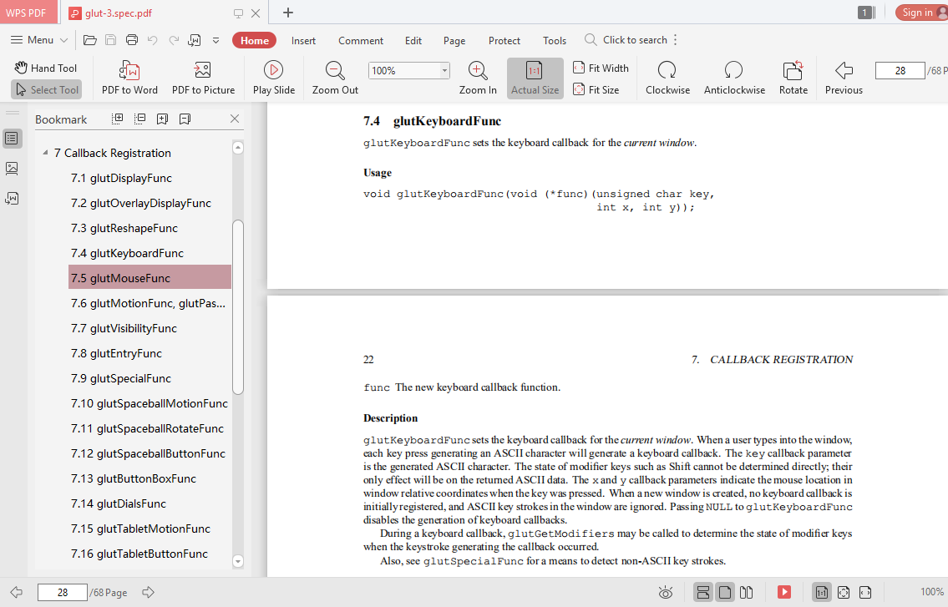
Windows-based programming

Slide 12
Keyboard Event
Normal Key
- Callback function Prototype:
void myKeyboard(unsigned char key, int x, int y);
- Register callback function
glutKeyboardFunc(myKeyboard);
- Example
void myKeyboard(unsigned char key, int x, int y){
if(key == ‘Q’ | key == ‘q’)
exit(0);
}

Slide 13
Keyboard Event
Function Key
- Callback function Prototype:
void myKeyboard(unsigned char key, int x, int y);
- Register callback function
glutSpecialFunc(myKeyboard);
- Example
void myKeyboard(unsigned char key, int x, int y){
if (key == GLUT_KEY_LEFT) angle = angle + 5;
else if (key == GLUT_KEY_RIGHT) angle = angle - 5;
glutPostRedisplay();
}

Slide 14
Mouse Event
Mouse Click
- Callback function Prototype:
void myMouse(int button, int state, int x, int y);
which button (GLUT_LEFT_BUTTON,
GLUT_MIDDLE_BUTTON, GLUT_RIGHT_BUTTON)
caused event
state of that button (GLUT_UP, GLUT_DOWN)
Mouse Position in window
- Register callback function
glutMouseFunc(myMouse);

Slide 15


Mouse Event
Mouse Click
glutInitWindowSize(W, H);
Y’
X
t
x’, y’
W
l
r
X’
x, y
b
H
glOrtho(l, r, b, t, -1, 1);
Y
x’ = A.x + B
r = A.W + B
x’ = ((r-l)/W).x + l
y’ = ((b-t)/H).y + t
l = A.0 + B

Slide 16
Mouse Event
Mouse Move
glutMotionFunc: mouse buttons are pressed
glutPassiveMotionFunc: no mouse buttons are pressed
Callback Function Prototype
void myMoveMouse(int x, int y)

Slide 17
Reshape Event
original
reshaped

Slide 18
Reshape Event
The reshape callback
glutReshapeFunc(myreshape);
void myReshape( int w, int h)
Returns width and height of new window (in pixels)
A redisplay is posted automatically at end of execution of the callback
GLUT has a default reshape callback but you probably want to define your own
The reshape callback is good place to put viewing functions because it is invoked when the window is first opened

Slide 19
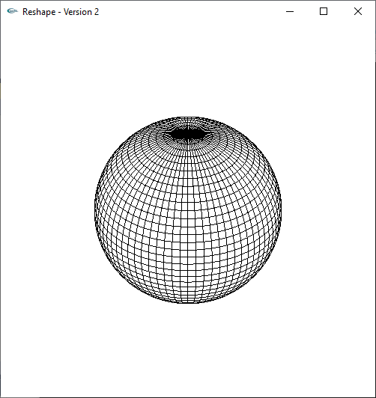
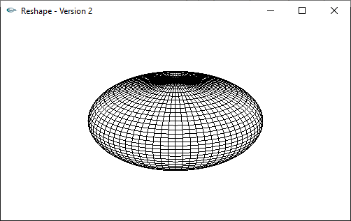
Reshape Event
void myReshape(int w, int h){
glViewport(0, 0, w, h);
}

Slide 20
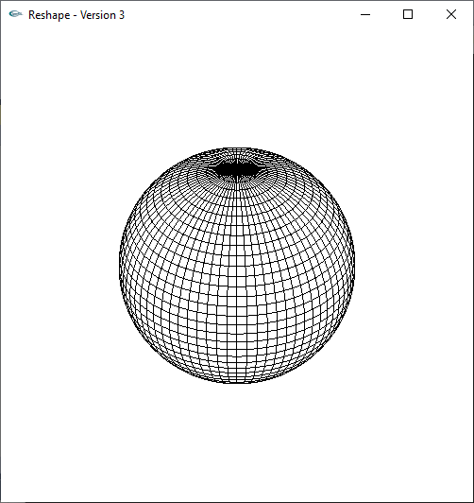
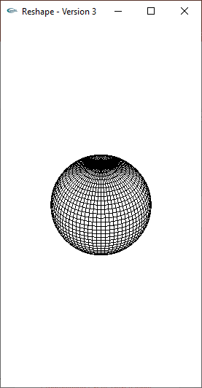
Reshape Event
2*(h/w)
h
-2
2
w
-2*(h/w)

Slide 21
Reshape Event
void myReshape(int w, int h){
float factor = 2;
glViewport(0, 0, w, h);
glMatrixMode(GL_PROJECTION);
glLoadIdentity();
if (w <= h)
glOrtho(-factor, factor, -factor * h / w,
factor * h / w, -10.0, 10.0);
else
glOrtho(-factor * w / h, factor * w / h,
-factor, factor, -10.0, 10.0);
}

Slide 22
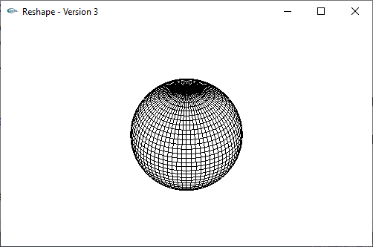
Reshape Event
2
-2*(w/h)
2*(w/h)
-2

Slide 23
Reshape Event
void myReshape(int w, int h){
float factor = 2;
glViewport(0, 0, w, h);
glMatrixMode(GL_PROJECTION);
glLoadIdentity();
if (w <= h)
glOrtho(-factor, factor, -factor * h / w,
factor * h / w, -10.0, 10.0);
else
glOrtho(-factor * w / h, factor * w / h,
-factor, factor, -10.0, 10.0);
}

Slide 24
Idle Event
The idle callback is executed whenever there are no events in the event queue
glutIdleFunc(myidle)
Useful for animations
void myidle() {
/* change something */
t += dt
glutPostRedisplay();
}
void mydisplay() {
glClear();
/* draw something that depends on t */
glutSwapBuffers();
}

Slide 25
Double Buffer
Double Buffering
Instead of one color buffer, we use two
Front Buffer: one that is displayed but not written to
Back Buffer: one that is written to but not displayed
Program then requests a double buffer in main.c
glutInitDisplayMode(GL_RGB | GL_DOUBLE)
At the end of the display callback buffers are swapped
void mydisplay() {
glClear(GL_COLOR_BUFFER_BIT|….)
/* draw graphics here */
glutSwapBuffers()
}

Slide 26
Toolkits and Widgets
Most window systems provide a toolkit or library of functions for building user interfaces that use special types of windows called widgets
Widget sets include tools such as
Menus
Slidebars
Dials
Input boxes
But toolkits tend to be platform dependent
GLUT provides a few widgets including menus

Slide 27
Toolkits and Widgets
Menus
GLUT supports pop-up menus
A menu can have submenus
Three steps
Define entries for the menu
Define action for each menu item
Action carried out if entry selected
Attach menu to a mouse button

Slide 28
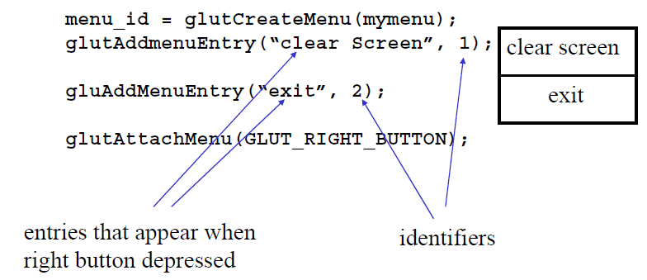
Toolkits and Widgets
Menus

Slide 29
Toolkits and Widgets
Menu
Menu callback
void mymenu(int id) {
if(id == 1) glClear();
if(id == 2) exit(0);
}
Note each menu has an id that is returned when it is created
Add submenus by
glutAddSubMenu(char *submenu_name,
submenu id)

